Slide 1
DEAL
Online Shop
SPRINT 2 SUMMARY

Slide 2
What we’ll discuss today?

Slide 3
01
SPRINT METRICS
02
06
TEAM
SPRINT 2 OBJECTIVES
07
MEMBER RETROSPECTIVE
03
SCRUM CEREMONIES
08
SCRUM MASTER RETROSPECTIVE
04
FLOW
09
FEEDBACK. QUESTIONS
05
ADVANCE FEATURES

Slide 4





TEAM (HORIA BRENCHU)
Cristi
Andrei
Cornel
Gabriel
Hunor
Scrum master
FE Tech Lead
BE Tech Lead
FE Developer
BE Developer
QA Developer

Slide 5
02 SPRINT 2 OBJECTIVES
Recovered from SPRINT 1:
Password recovery support
Role-based access control (RBAC)
User Profile
Product search with filters
Product listing and management
For Admins:
Assign categories to sellers
Manage product categories (CRUD)
Cart Management
For the current sprint (2) :
Improvement of the user profile
Add image upload with ImgBB
Defined the flows and restriction for a user if wants to become a seller
Order placement integrated with Stripe and having 3D Secure checks
Cronjob and notifications for real-time status updating of the order on server and client sides
Order management, and different possibilities of viewing
Added filters, searching, visualisations of products
Bonus added pagination
Order history management
Improved dashboard of the admin
Recommendation engine using Neo4J
Continuing the automation test for different screens

Slide 6
03 SCRUM CEREMONIES
🧭 1. Sprint Planning
Held at the start of each sprint
Team discusses what can be delivered and how the work will be accomplished
Stories are broken down into tasks and assigned story points
Output: a Sprint Backlog with a clear sprint goalCreated architecture diagrams
🗓️ 3. Stand-up (Daily Scrum *)
We tried to keep updated on Teams / WhatsApp
Each member answers:
What did I do yesterday?
What will I do today?
Are there any blockers?
Promotes transparency, team alignment, and quick issue detection automation framework
🔁 2. Backlog Refinement (Grooming)
Ongoing process during sprint
Ensures backlog items are clear, estimated, and prioritized
Helps the team stay ready for future sprints
🗓️ 4. Retrospective
Internal team meeting after the Sprint Review
Reflects on how the sprint went (not what was built)
Focus on process improvement:
What went well?
What didn’t?
What can be improved next sprint?
Output: concrete action items to enhance team performance

Slide 7
04 FLOW
1. 📖 Understand the Task
Read the Jira story and acceptance criteria
Confirm labels: FE, BE, Tech, etc.
Ask clarifying questions if needed (Slack, grooming, comments)
2. 🗓️ Create the Feature Branch
feature/DEAL-[JIRA-ID]/short-task-description
3. 🗓️ Create the Subfeature Branch
subfeature/FE/DEAL-[JIRA-ID]/short-task-description
subfeature/BE/DEAL-[JIRA-ID]/short-task-description
4. 🧱 Develop Your Feature
Implement based on story details
Commit often, clearly, and locally
UP TO DATE: feature into main, subfeature into feature
5. 🧪 Test the Feature
BE Unit tests
Manual test UI/UX
Validate with acceptance criteria
Update coverage if required
7. 📝 Create Merge Request (Subfeature → Feature)
🔖 Name: [Subfeature][FE][DEAL-1234] - Add login form
✅ Review with team
✅ Wait for approval
8. 📝 Final merge request for feature after integration)
9. 📝 Make automation feature for QA testing (decided by the scrum master and QA Tester)

Slide 8
05 ADVANCE FEATURES - STRIPE
🔐 Secure Payment Processing Architecture
Stripe Payment Intent API - Creates secure payment sessions with client-server separation
PCI DSS Compliance - Stripe handles sensitive card data, reducing security burden
Server-side Payment Intent Creation - Backend generates payment intents with order metadata
Client-side Payment Confirmation - Frontend securely confirms payments using Stripe Elements
Implementation
Step 1: Customer Details Collection - Captures billing information and customer data
Step 2: Payment Intent Generation - Backend creates Stripe PaymentIntent with order amount and metadata
Step 3: Secure Card Processing - Frontend uses Stripe Elements for PCI-compliant card input
Step 4: Payment Confirmation - Stripe confirms payment and returns success/failure status
Step 5: Order Creation - Only creates order in database after successful payment verification
🏗️ Technical Architecture Components
Backend StripeService - Handles PaymentIntent creation and Stripe API communication
Frontend Stripe Context - Manages payment state and error handling across components
Payment Intent Metadata - Stores order details, customer info for transaction tracking
🔄 Order State Management
Payment-First Approach - Payment processed before order creation to prevent failed transactions
Order Status Tracking - PENDING → PROCESSING → SHIPPING → DONE state machine
Stock Validation - Checks product availability during order creation
Transaction Rollback - Handles failed payments without creating incomplete orders
🛡️ Security & Error Handling
Environment-based Configuration - Separate test/production Stripe keys
Comprehensive Error Handling - Card declined, insufficient funds, network errors
Payment Verification - OTP-based confirmation for additional security layer
Metadata Tracking - Customer details stored in Stripe for audit trails
🎯 Advanced Features
Real-time Payment Status - Live updates during payment processing
Test Card Support - Development environment with test card numbers
3D Secure with simulation of captcha and SMS code message checks
Multi-currency Support - Configurable currency handling (USD, EUR, etc.)
Responsive UI - Modern checkout experience with Ant Design components
Cart Integration - Seamless transition from shopping cart to payment
This Stripe integration represents a production-ready payment system that ensures secure, reliable order processing while maintaining excellent user experience and comprehensive error handling.

Slide 9
05 ADVANCE FEATURES – PRODUCT RECOMMANDATION WITH NEO4J
🔗 Graph Database Architecture
Neo4j Integration - Dedicated graph database for modeling complex user-product relationships
Dual Database Strategy - PostgreSQL for transactional data, Neo4j for recommendation analytics
Real-time Synchronization - ProductSyncService maintains data consistency between databases
Spring Data Neo4j - Seamless integration with Spring Boot ecosystem
📊 Graph Data Model
User Nodes - Represent customers with unique user IDs and relationship tracking
Product Nodes - Store product information with category associations
ProductCategory Nodes - Enable category-based recommendation clustering
Relationship Types - VIEWED, PURCHASED, HAS_CATEGORY for behavioral tracking
🎯 Intelligent Recommendation Algorithm
Category-Based Recommendations - Suggests products from categories user has interacted with
Collaborative Filtering - Recommends popular products purchased by other users
Fallback Strategy - Shows trending products when insufficient user data exists
Personalization Logic - Excludes already viewed/purchased items for fresh suggestions
🧠 Algorithm Overview
Hybrid Two-Tier Approach - Category-based filtering + Collaborative filtering fallback
Smart Logic - Recommends products from user's preferred categories, excludes already seen items
Fallback Strategy - Shows popular products when insufficient personalized data available
Minimum Guarantee - Ensures at least 4 recommendations or falls back to trending products
🏗️ Technical Architecture
Repository Pattern - Clean separation with ProductNodeRepository and UserNodeRepository
Service Layer - RecommendationService handles business logic and algorithm execution
REST API - /recommendations/{userId} endpoint for personalized suggestions
Error Handling - Graceful degradation when graph data unavailable
🔄 Data Synchronization
Auto-Sync Operations - Create/Update/Delete products automatically synced to graph database
Transaction Safety - Ensures PostgreSQL ↔ Neo4j consistency
Real-time Tracking - User views and purchases instantly recorded in graph
Category Management - Product category changes reflected in graph relationships
📈 Business Intelligence
User Behavior Analytics - Deep insights into customer preferences and patterns
Cross-selling Opportunities - Category-based recommendations increase basket size
Personalized Experience - Tailored suggestions improve user engagement
Scalable Architecture - Graph database efficiently handles complex relationships
🎨 Frontend Integration
Seamless UX - Invisible tracking via ProductCard component clicks
Performance Optimized - Asynchronous API calls prevent UI blocking
Error Resilience - Graceful handling of recommendation service failures
Real-time Updates - Fresh recommendations based on latest user interactions
🔧 Development & Testing
Comprehensive Testing - Unit tests for all recommendation components
Docker Integration - Neo4j containerized for consistent development environment
Test Data Seeding - Cypher scripts create realistic user-product scenarios
Mock Testing - Isolated validation of recommendation algorithms

Slide 10
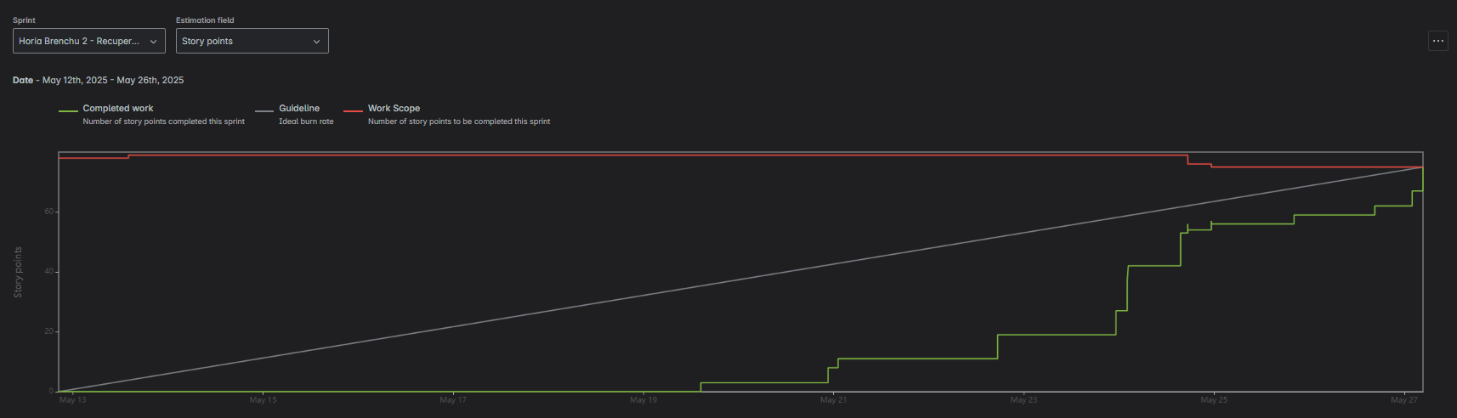
06 SPRINT METRICS
The team started slowly but accelerated delivery at the end of the sprint, eventually completing all planned story points(the one in final was finished a few hours later). The work scope remained steady, indicating minimal scope change during the sprint.

Slide 11
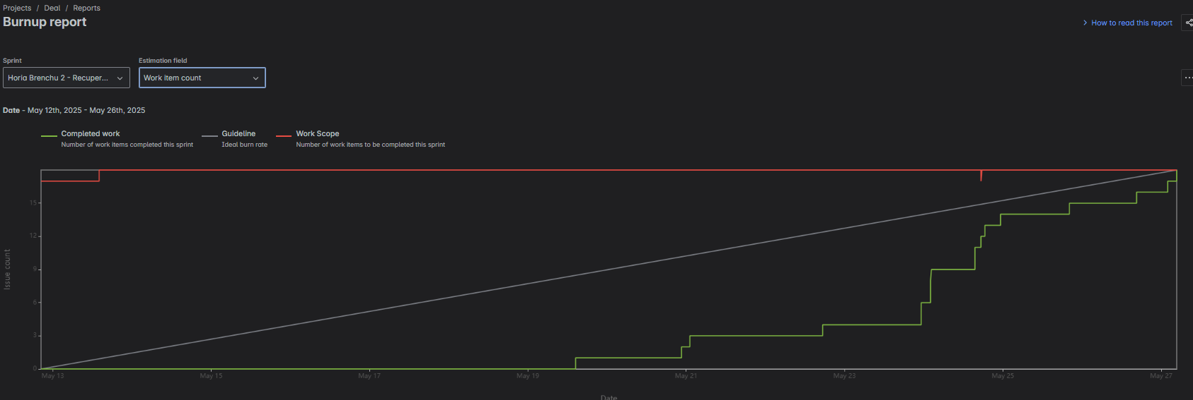
06 SPRINT METRICS
The team completed all planned work items by the end of the sprint, matching the total work scope. Most progress occurred in the last days, after a slow start.

Slide 12
06 SPRINT METRICS
The team completed all planned work items by the end of the sprint, matching the total work scope. Most progress occurred in the last days, after a slow start.

Slide 13
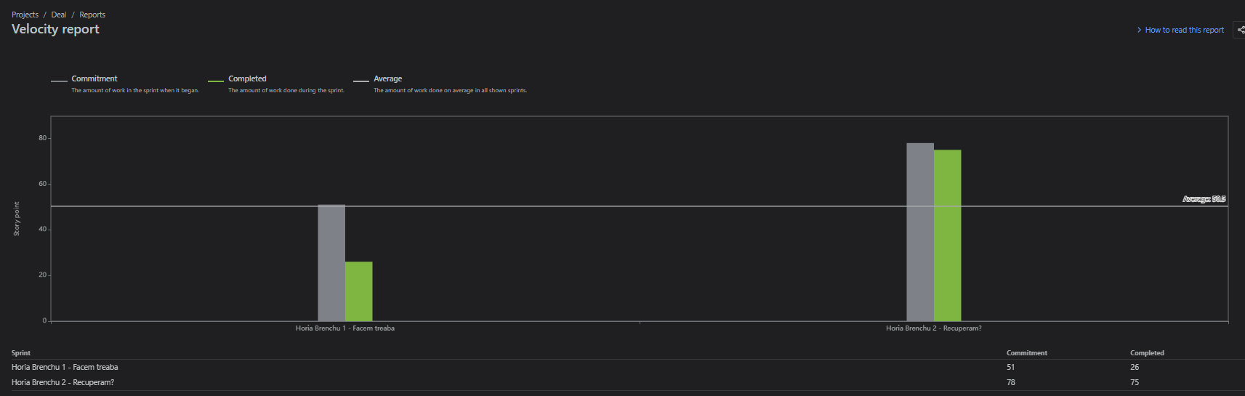
06 SPRINT METRICS
The team’s velocity improved significantly in the second sprint, with almost all committed story points completed (the last 3 points were finished with a slight delay). This shows increased predictability and delivery performance compared to the first sprint.

Slide 14
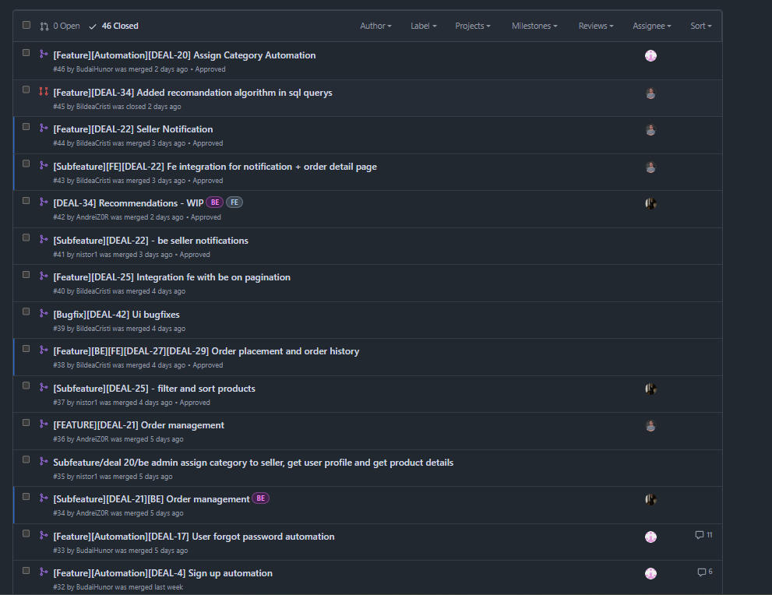
06 SPRINT METRICS

Slide 15
06 SPRINT METRICS
📋 Project Management
17 Jira Tickets Completed - 100% sprint commitment delivered on time
2 Advanced Features Implemented - Stripe Payment Integration & Neo4j Recommendations
46 Pull Requests Merged - High development velocity with quality code reviews
Zero Critical Bugs - Robust development process with comprehensive testing
💻 Code Metrics
Total Codebase: 30,954 Lines - Substantial application with enterprise-level complexity
280 Files Created/Modified - Comprehensive feature development across all layers
26,871 Lines of Production Code - 87% code density indicating efficient implementation
551 Comment Lines - Well-documented codebase for maintainability
🏗️ Architecture Distribution
Frontend (React/TypeScript): 16,402 lines - Modern UI with 98 component files
Product Service: 4,223 lines - Core business logic with Neo4j integration
Identity Service: 2,934 lines - Authentication and user management
Notification Service: 941 lines - Real-time communication system
🔧 Development Quality
High Code Density: 87% - Minimal bloat, focused on functional implementation
Low Comment Ratio: 1.8% - Self-documenting code with clear naming conventions
Automation Scripts: 851 lines - Automation tests implemenations
Microservices Architecture - Scalable, maintainable service separation
⚡ Sprint Achievements
Advanced Payment Processing - Production-ready Stripe integration with security
AI-Powered Recommendations - Graph database analytics for personalization
Full-Stack Implementation - End-to-end feature delivery from UI to database
Enterprise Standards - Professional code quality with comprehensive testing
📊 Technical Highlights
Multi-Database Strategy - PostgreSQL + Neo4j for optimal performance
Modern Tech Stack - React, Spring Boot, Docker, microservices
Security Implementation - JWT authentication, payment encryption, data protection
Scalable Design - Cloud-ready architecture with service discovery

Slide 16
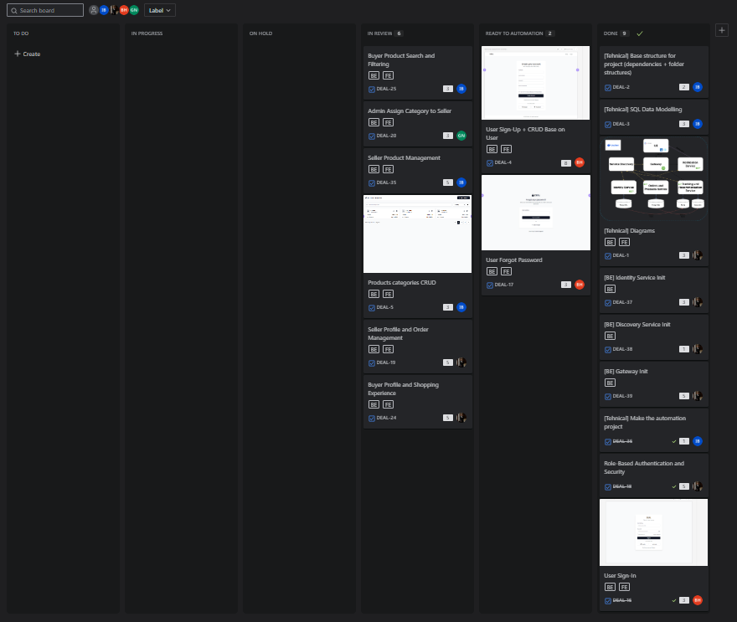
06 SPRINT METRICS

Slide 17
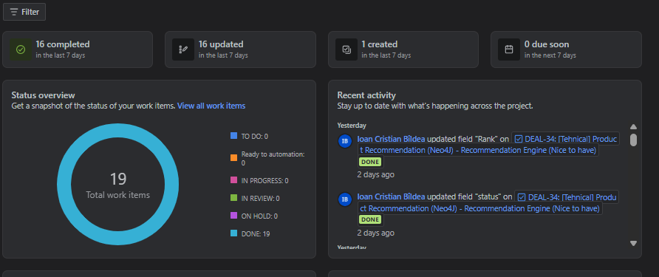
06 SPRINT METRICS
The outcome is that we successfully completed the sprint work items. The lessons learned and conventions established during Sprint 1 made a significant difference in enabling us to finish. Additionally, the team’s integration with the technology stack, git, and workflow improved. However, attention to detail, discipline, and individual velocity did not increase equally among all team members.

Slide 18
07 MEMBER RETROSPECTIVE Andrei

Slide 19
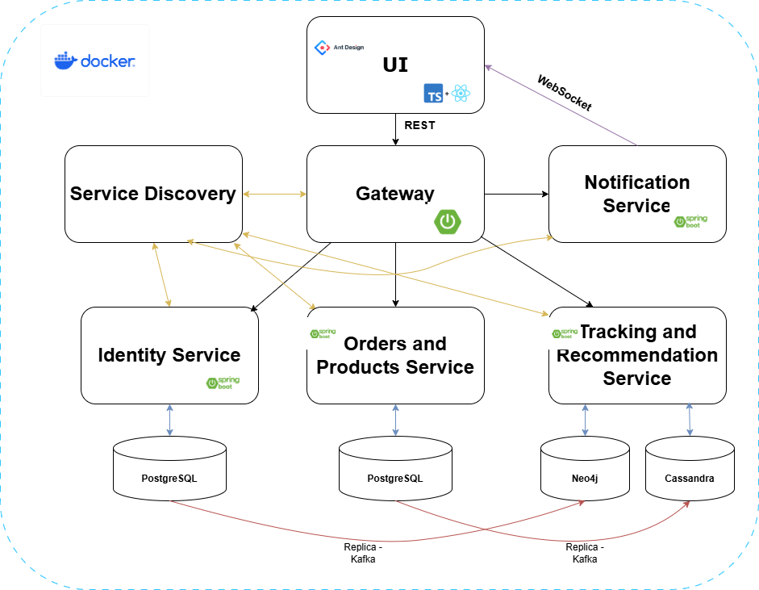
Andrei Borza – Dev life
Completed tasks:
Products management, including filtering and searching with complex options
Order management system, history and processing, including checking for available stock, auto-updating stock after the order is processing, multiple order states and an automatic order processor (FSM)
Product recommendation system, based on the user’s activity and purchase history, also taking into consideration global trends
Exception handling & paginated response uniformization
Code review & Bug fixing & Technical Improvements
Technical Implementation:
Running up a Neo4J DB configured to be plug and play
for each teammate, also pre-populating with valid data
Automatic sync between Postgres & Neo4J, transaction management and well-defined DB schemas, ensuring maximum performance and lower data duplication
New service kept at a impressively high 93% code coverage, with an average of 93.5% accros the project

Slide 20
Andrei Borza - Retrospective
What went well:
STILL Regular meetings & check-ups, if anyone had a problem someone was there to help
Managed to (almost) finish the work expected
What was challenging:
Lowered code standards was not easy, but it helped delivering sooner -> would not recommend
What can be improved:
Branch chaos, not enough attention on updating branches, parts of code changed and/or accidentally lost -> do it again… -> STILL
STILL low attention to details, rushed tickets
PRO TIP: Stop being attached to your code, it’s not sustainable in the long run, be more open to ideas and stick to the agreed plans

Slide 21
07 MEMBER RETROSPECTIVE Cornel

Slide 22
What I did for the team
I worked on the Frontend part of our application delivering next tasks:
Seller Order Management
Buyer Product Visualization
Refactored existing tasks
Implemented tasks using a modular React component-based architecture, designing and validating reusable components to ensure maintainability and scalability.

Slide 23
In retrospect
Everything went smoothly during the sprint, and I managed to complete my planned tasks.
However, time was a challenge for me, so I wasn't able to dedicate as much effort as I would have liked.
I am happy with the work I put in this 2 sprints

Slide 24
07 MEMBER RETROSPECTIVE Gabriel

Slide 25
Nistor Ioan-Gabriel
Completed Tasks: I have implemented a real-time notification system for order status updates, the assign category functionality, product details retrieval, fetching a list of categories from a list of IDs, and unit tests.
Technical Implementation:
Notifications: Notification service setup and a /notify endpoint that’s sends notifications to the frontend, using websocket when order status is changed.
Assign category functionality: Updates the user by adding a set of categories.
Get user profile by fetching category details from the Product Service, and get product details by retrieving associated category information.
Filter and sorting: Filter products by category ID and product name. Sort products alphabetically (A–Z, Z–A) or by price (lowest to highest, highest to lowest).

Slide 26
Nistor Ioan-Gabriel
What went well: Team communication was effective, which helped us stay aligned throughout the sprint and resolve tasks efficiently.
We supported each other through regular meetings and group communication, which helped us stay organized and make steady progress during the sprint.
Challenge faced: One of the main challenges was recovering and completing the features that we couldn’t finish during Sprint 1, ensuring they were successfully delivered in the current sprint.
Improvements: We could improve our workflow by creating larger tickets that group together multiple related functionalities, allowing for better cohesion and more efficient implementation.

Slide 27
07 MEMBER RETROSPECTIVE Hunor

Slide 28
Budai Hunor
Completed Tasks: I have implemented automation testing for the Sign Up, User forgot password, and Admin assign category to seller processes.
Technical Implementation:
Implemented using Selenium WebDriver to create automation tests for each task.

Slide 29
Budai Hunor
What went well: Team work was efficient, which improved the workflow, and communication was also effective because of the group meetings.
Challenge faced: One of the main challenges working with the project’s complex structure.
Improvements: Having more readme files or comments in the code with explonations.

Slide 30
08 SCRUM MUSTER RETROSPECTIVE Cristi

Slide 31
What I did for the team
I worked as Scrum Master managing team progress and also on the FE part and some parts of BE of our application delivering next tasks
User profile, dashboard for user and admin FE
Defined seller flow if has store adress
Product Category and Product Management, improved UI and integrations FE
Cart Management
Order Placement flow FE, by integrating FE
Stripe Intregation on BE
Integrated Order Real-Time Status and management
Notification integration FE
Pagination intregated FE
Recommandation page integration FE
Reviews
DEV Suport
All endpoint integrations, bug fixing
Improved overall UI, extracting common components

Slide 32
In retrospect
Throughout the sprint, I tried to maintain a steady pace with my tasks and made an effort to communicate actively with team members, offering support and feedback whenever needed.
Balancing the workload was a challenge, especially as we worked to complete both this sprint’s tasks and unfinished items from the previous sprint.
I’m pleased that we managed to complete all the tasks planned for this sprint, and overall, I’m satisfied with the team’s performance.
I observed a notable improvement in the involvement and technical skills of several team members, which had a positive impact on our delivery.
However, I would have appreciated greater transparency within the team, especially regarding individual progress and blockers—better communication would help us address issues sooner.
The velocity wasn’t consistent across all team members; I believe it’s important that we strive for a more balanced workload and contribution to avoid bottlenecks and ensure a steady pace.
Discipline and seriousness remain areas for improvement—by being more attentive to agreed processes and deadlines, we can boost our effectiveness and quality even further.
I suggest we focus on maintaining open communication, supporting each other, and reinforcing our commitment to team standards and shared goals.

Slide 33

THANKS!
09
FEEDBACK. QUESTIONS

